Slide 1
Sysmon Sysinternal Telemetry and Threat Intelligence
Team Members:
Malavika Reddy Kotha

Slide 2
Literature review and analysis, project plan
Introduction:
The cyber security threats are on the rise, and this brings risks to organizations and individuals. The traditional threat detection systems are based on the rules and do not recognize new and advanced threats. The use of AI in threat detection helps the system to learn from previous events or attacks and detect the threats.
In this project, we use Sysmon to collect system logs and give these logs to Splunk to preprocess them. This processed data will be input for the ML model. Our goal is to develop an AI-based system which automatically classifies and detect threats.

Slide 3
Abstract
The goal is to create an AI model that can identify and classify threats using Sysmon logs and present security findings in a Splunk dashboard.
Sysmon will be used to log system events, process creations, file modifications/creations, and network connections.
Splunk will be used to fetch the Sysmon logs, parse, and preprocess the data.
The data that has been prepared will be used as input for the ML/AI model that performs the threat identification and classification.
The Splunk dashboards will be developed to provide visualizations that can assist security analysts in enhancing the effectiveness of threat response and providing meaningful conclusions.

Slide 4
Business Need
Due to the increase in cyber attacks on organizations and government institutions, this results in financial losses, damage to the organization’s image, legal consequences, and many others. According to the 2024 IBM report, the cost of a data breach rose by 10% to $4.88 million, from $4.45 million in the previous year.
Many organizations use manual log analysis and rule-based systems for threat detection. As a result of the growing number and complexity of threats, analyzing logs manually results in delayed incident response, increased risks, human errors, and missed threats.
Organizations need intelligent solutions to detect and respond to such threats in real time. The AI-powered threat detection system processes Sysmon logs using Splunk, and an ML model will automatically detect and classify threats. This helps in reducing the time to respond, the chances of human error, and helps organizations to avoid risks.

Slide 5
Problem Statement
The traditional cybersecurity approaches are slow, inelegant, and require more effort to implement, security analysts review logs using SIEM and other endpoint detection tools to identify threats. This is a slow process and can result in increased incident response time, more vulnerabilities, and financial loss; sometimes it can take weeks or months to detect a threat.
Organizations need intelligent and faster systems to detect these threats to avoid the consequences discussed above.
The main aim of our project is to design an AI-based threat detection system using Sysmon logs, Splunk, and ML models to automate this security monitoring task. This helps in reducing the human errors, enhance the threat detection, and decreases response time.

Slide 6
Solution
Integrating Sysmon logs with Splunk for structured data processing.
Developing AI models to classify threats based on historical Sysmon logs.
Visualizing results in Splunk for easy analysis and security decision-making

Slide 7
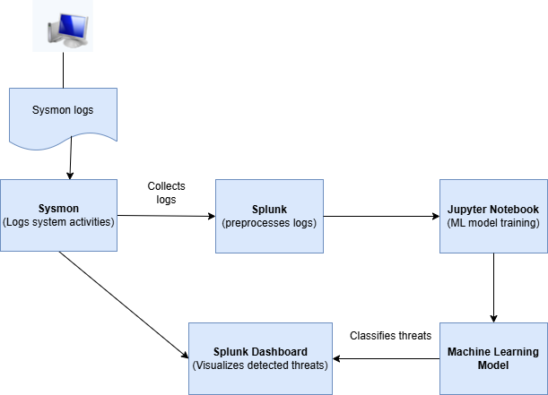
High-Level Architecture

Slide 8
Minimum Viable Product (MVP)
Our project's main goal is to develop a fully working AI-based threat detection system that can make automatic decisions on threats using Sysmon logs, Splunk, and machine learning models. We also want to ensure that there are no disturbances in the data flow from logging to detection, and the analysis and visualization are real-time.
Data collection & preprocessing:
- Enable Sysmon for system events tracking such as process creation, network connections, and file changes.
- Employ Splunk to gather and analyze Sysmon logs and eliminate unnecessary information and prepare it for analysis.
AI-Powered threat detection:
- Export the preprocessed logs from Splunk into a Jupyter notebook for training of the ML models.
- Train multiple ML models on the attacks based on their patterns in the past.
- Assess the models by their precision, recall, F1 score, and AUC-ROC to achieve optimal results.
Security insights & visualization:
- Develop Splunk dashboards that can present security patterns, identified threats, and system exceptions for better visualization.
By using this MVP, we can create a real-time AI-based threat detection system to enhance the security team's ability to easily identify and respond to the threats.

Slide 9
Gantt Chart
Week | Task
week 1-2 | Literature Review & Data Collection (Sysmon + Splunk Setup)
week 3-4 | Data Preprocessing & Feature Engineering
week 5-6 | Model Development (ML/AI models)
week 7 | Model Evaluation & Optimization
week 8 | Deployment & Dashboard Creation

Slide 10
Peer-Reviewed Articles
1. AI and Machine Learning: A Mixed Blessing for Cybersecurity by IEEE, 2020 Link
2. Enhancing Cybersecurity Incident Response: AI-Driven Optimization for Strengthened Advanced Persistent Threat Detection by Gauhar Ali, Sajid Shah, Mohammed ElAffendi Link
3. Cyber Attack Prediction: From Traditional Machine Learning to Generative Artificial Intelligence Link
4. Cybersecurity Data Science: An Overview from Machine Learning Perspective by Iqbal H. Sarker et al. Link
5. Leveraging Machine Learning for Cybersecurity Resilience in Industry 4.0: Challenges and Future Directions by Jia Yu, Alexey V. Shvetsov, Saeed Hamood Alsamhi Link
6. Real-Time Detection System Against Malicious Tools by Monitoring DLL on Client Computers by 2019 IEEE Conference on Application, Information and Network Security Link
7. The Rise of Cognitive SOCs: A Systematic Literature Review on AI Approaches by Farid Binbeshr, Muhammad Imam, Mussadiq Abdul Rahim, Mohammad Hammoudeh Link

Slide 11
Thank You

